Slide 1
Python
Programming Logic

Slide 2
Intro
Up until now we have been dealing with sequential programs - the program executes line by line until the last line.
Python also supports structures known and selection and iteration.

Slide 3
Selection
A selection structure is like a decision.
It provides programmers with a branching mechanism whereby certain blocks of code may be either executed or skipped at runtime.
The decision of which block of code to select for execution depends on the result of a condition also known as a Boolean expression.
The main Python keywords used to support decision structures are if, else and elif.

Slide 4
Boolean Logic
Boolean Logic was invented by the mathematician George Boole who was the first professor of Mathematics at UCC.
The algebra on which Boolean Logic is based is used to build electronic circuits and write computer programs.
Boolean logic forms the basis of all modern digital devices and software systems.

Slide 5
Boolean Expressions
At any given moment in time, a Boolean expression will evaluate to either True or False. It can never be anything in between.
True and False are two Python keywords which technically behave as if they were the numbers 0 and 1.
A simple boolean expression uses a single relational operator (<, >, =) to compare two values.
Example:
7>3 evaluates to True
8<4 evaluates to False

Slide 6
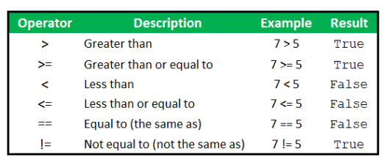
Python Relational Operators

Slide 7
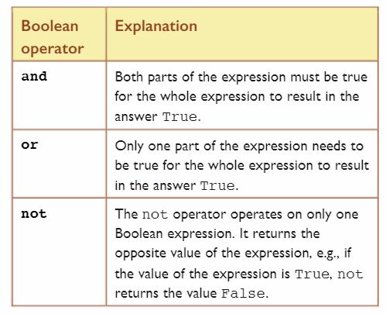
Boolean Operators
Boolean expressions can be combined using additional boolean operators
and
or
not

Slide 8
Selection - if, else, elif
Selection statements are used by programmers to build alternative execution paths through their code. These are known as decision statements.
Python provides built in supports for three different kinds of selection statements:
Single option (basic if statement)
Double option (the if-else statement)
Multiple option (if-elif-else statement)
When a running program executes a selection statement, it evaluates a condition, and based on the result of this evaluation it will decide which statement to execute next.

Slide 9
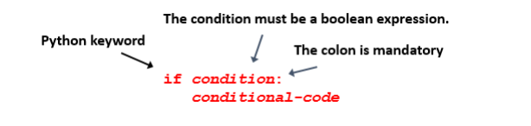
The basic if statement
If Python evaluates the conditional statement to be True, then the conditional code will be executed.
If Python evaluates the conditional statement to be False, then the conditional code is skipped and the programs continues to the next line of code.
NOTE: The colon and indentation of the conditional code is mandatory

Slide 10
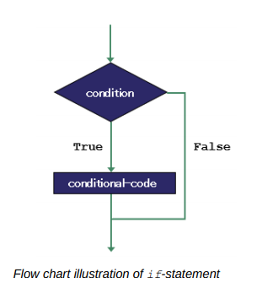

Slide 11
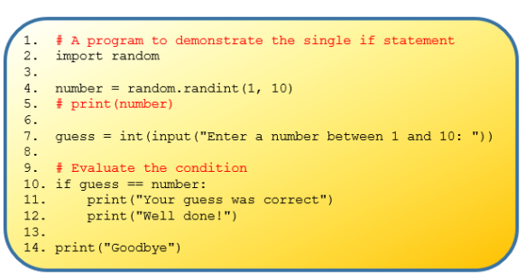

Slide 12
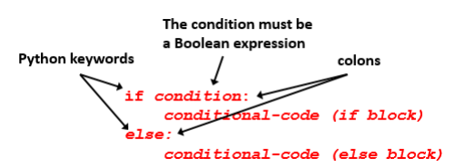
If-else statement
If Python evaluates the condition to be True, then the block of code associated with the if block is executed.
Otherwise, the block of code associated with the else block is executed.
Only one block will run, never both.

Slide 13
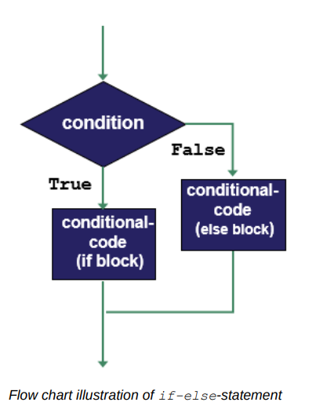

Slide 14
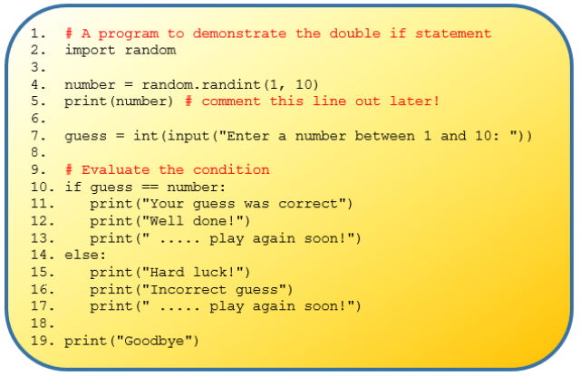

Slide 15
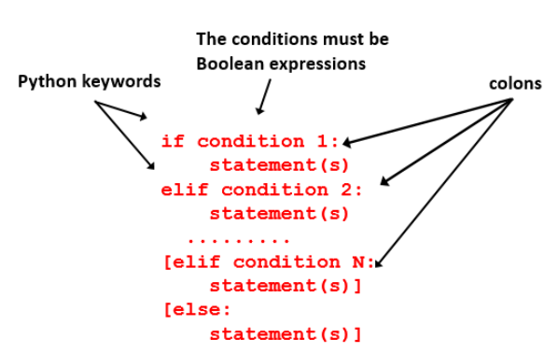
If-elif-else statement

Slide 16
if-elif-else
The first condition is always inside an if statement
There can be as many elif statements as required.
Each elif statement must include a condition
The use of a final else statement is optional
The if, elif and else keywords must all be at the same level of indentation
A colon must be used at the end of any lines containing if, elif and else
Each condition is evaluated in sequence. Should Python evaluate a condition to be True, then the associated statements are executed and the flow of control continues from the next line following the end of the entire if-elif statement
If none of the conditions are found to be True then Python executes any statements associated with the else

Slide 17
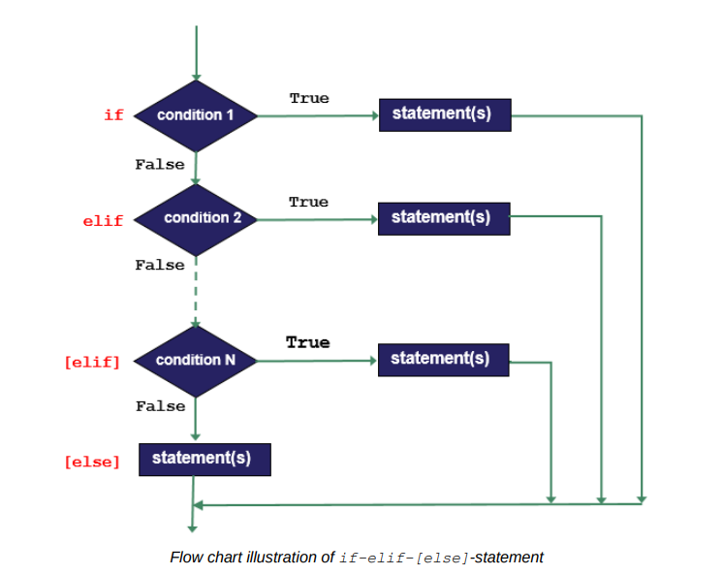

Slide 18
